Slide 1


CSE380: Programming in Java Topic: Variables & their Scope

Slide 2
Outlines
[Expected Time: 1 Hours]
Variables and their Scope
Local Variables
Instance Variables
Class (static) Variables

Slide 3
Variables
Variables are the data members or the fields defined inside a class.
There are three types of variables:
Local Variables
Instance Variables
Class Variables

Slide 4
Local Variables
Declared in methods, constructors, or blocks.
Scope: Bloclk level.
Visibility: inside the block only,
they can’t be accessed outside the scope of that block.
class abc{
public static void main(String args[])
{
int a=5; // local variable
System.out.println(a);
}
}

Slide 5
Important
Access modifiers are NOT ALLOWED with local variables.
Local variables are created in STACK.
Default value is NOT ASSIGNED to the local variables in Java.
error: variable a might not have been initialized

Slide 6
Instance Variables
Declared inside a class only,
Not inside any method, constructor, or static block.
They belong to individual objects (instances) of that class
Each object gets its own copy of these variables.
They are created inside the object in heap.
They can be accessed/modified separately using object reference.
public class Car {
String color; // instance variable
int speed; // instance variable
public Car(String c, int s) {
color = c;
speed = s;
}
}

Slide 7
Instance Variables cont…
Created when an object is created use of the 'new' keyword.
Destroyed when the object is destroyed.
Access modifiers can be used with instance variables.
Instance variables have default values
(Initialization is not mandatory, JVM will take the default value)
For numbers the default value is 0,
for Booleans it is false
and for object references it is NULL.

Slide 8
Class (Static) Variables
Class variables are also known as static variables.
Variable which are declared in a class, outside any block.
Qualified with ‘static’ keyword.
Only one copy of each class variable is created,
regardless of how many objects are created from it.
Static variables can be accessed by calling with the class name.
ClassName.VariableName
class A {
int data = 50;//instance variable
static int m = 100;//static variable
void method() {
int n = 90;//local variable
}
}//end of class

Slide 9
Static variables are created with the start of execution of a program and destroyed when the program terminates.
Default values are same as instance variables.
A public static final variable behaves as a CONSTANT in Java.
Static variables can be initialized using static block also.
Used when we don’t want to modify the value from object to object.

Slide 10
Example
class A {
int data = 50;//instance variable
static int m = 100;//static variable void method() {
int n = 90;//local variable
}
}//end of class class Test { public static void main(String[] rk) {
System.out.println(A.m); // ✅ accessing via class name
A obj = new A();
System.out.println(obj.m); // ✅works, but not best practice }
}

Slide 11
Variable Initialization
Local variables must be initialized explicitly by the programmer as the default values are not assigned to them
Instance variables and static variables are assigned default values if they are not assigned values at the time of declaration.

Slide 12
Data Type | Default Value | Default size
boolean | false | 1 bit
char | '\u0000' | 2 byte
byte | 0 | 1 byte
short | 0 | 2 byte
int | 0 | 4 byte
long | 0L | 8 byte
float | 0.0f | 4 byte
double | 0.0d | 8 byte

Slide 13
Memory allocation in java (2 types: Stack and Heap memory)
Stack Memory in Java is used for static memory allocation and the execution of a thread. It contains primitive values that are specific to a method and references to objects that are in a heap, referred from the method.
Access to this memory is in Last-In-First-Out (LIFO) order. Whenever a new method is called, a new block on top of the stack is created which contains values specific to that method, like primitive variables and references to objects.
When the method finishes execution, it’s corresponding stack frame is flushed, the flow goes back to the calling method and space becomes available for the next method.

Slide 14
Stack Memory
It grows and shrinks as new methods are called and returned respectively
Variables inside stack exist only as long as the method that created them is running
It's automatically allocated and deallocated when method finishes execution
If this memory is full, Java throws java.lang.StackOverFlowError
Access to this memory is fast when compared to heap memory

Slide 15
Heap memory
Heap space in Java is used for dynamic memory allocation for Java objects and JRE classes at the runtime. New objects are always created in heap space and the references to this objects are stored in stack memory.
These objects have global access and can be accessed from anywhere in the application.
This memory model is further broken into smaller parts called generations, these are:
Young Generation – this is where all new objects are allocated and aged. A minor Garbage collection occurs when this fills up
Old or Tenured Generation – this is where long surviving objects are stored. When objects are stored in the Young Generation, a threshold for the object's age is set and when that threshold is reached, the object is moved to the old generation
Permanent Generation – this consists of JVM metadata for the runtime classes and application methods, static or class variables also.

Slide 16
Key features of Heap memory
It's accessed via complex memory management techniques that include Young Generation, Old or Tenured Generation, and Permanent Generation
If heap space is full, Java throws java.lang.OutOfMemoryError
Access to this memory is relatively slower than stack memory
This memory, in contrast to stack, isn't automatically deallocated. It needs Garbage Collector to free up unused objects so as to keep the efficiency of the memory usage

Slide 17
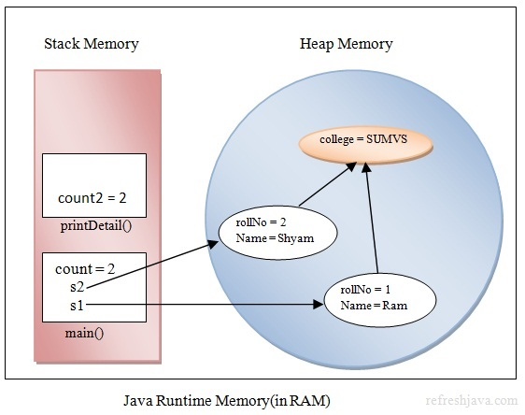
Here rollNo, Name are object specific attributes(instance variables). college is the static member(or class variable), s1 and s2 are references to the objects, printDetail() is the method, count and count2 are the local variables of their respective methods
Memory layout

Slide 18
Brainstorming 1
What will be the output of the following Program?
class Test {
public static void main(String[] rk) {
int x = 10;//if used without initialization will give error(int x)
System.out.print(x);
}
}
Notes:
Local variable

Slide 19
Brainstorming 2
What will be the output of the following Program?
class Test {
static int x;
public static void main(String[] rk) {
System.out.print(x);
}
}
Notes:
Instance Variable

Slide 20
Variable Using Object
class Test {
int x;
public static void main(String[] rk) {
Test t =new Test();
System.out.print(t.x);
}
}
//output: 0

Slide 21
Brainstorming 3
What will be the output of the following Program?
class Test {
static int x;
public static void main(String[] rk) {
System.out.print(Test.x);
//OR System.out.print(x);
}
}
Notes:
Class/ Static Variable

Slide 22
Data Types
Data types represent the different values to be stored in the variable.
In Java, there are two types of data types:
Primitive data types
Non-primitive data types

Slide 23
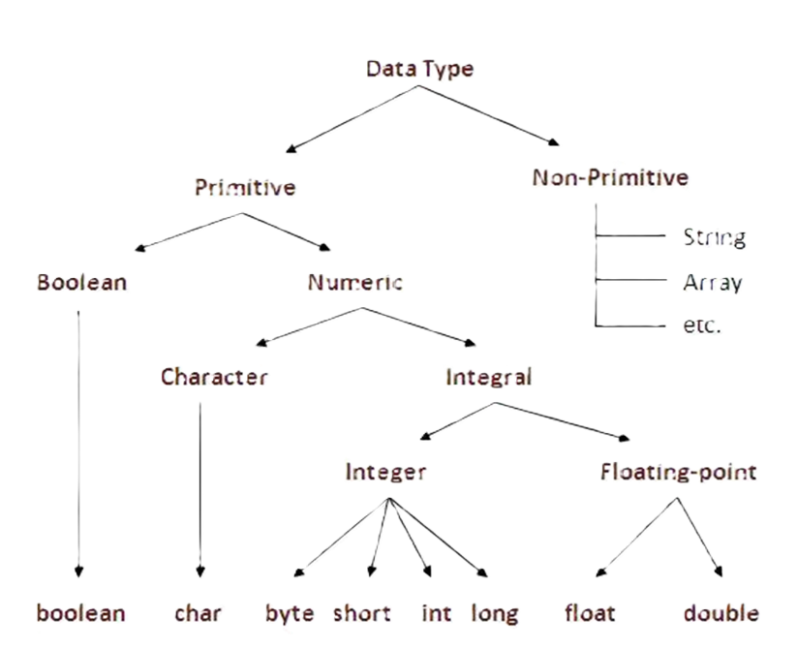

Slide 24
Data types
Data Type: The kind of data a variable can hold (like numbers, text, etc.).
Primitive: Built-in types that hold simple values, not objects.
Boolean: Represents true/false values (boolean).
Numeric: Represents numbers, including characters and numeric values.
Character: Stores a single 16-bit Unicode character (char).
Integral: Numeric types for whole numbers.
Integer: Stores whole numbers (byte, short, int, long).
Floating-point: Stores numbers with decimal parts (float, double).
Non-Primitive: Reference types like classes, arrays, and objects.
String: Sequence of characters treated as an object.
Array: Container object that holds multiple values of the same type.
etc.: Other user-defined types like classes, interfaces, and enums.

Slide 25


